Slide 1


Slide 2

Royal University for Women
“Women and Society Conference”
Key-note Speech
“Bahraini Women: Leading By Example”
H.E. Hala Mohamed Jaber Al Ansari
Secretary General of the Supreme Council for Women
19 April 2016

Slide 3



Bahraini Women Empowerment
Women in decision-making positions
Women in Education
2010
First woman government spokesperson.
2005
First Minister of Social Development.
2004
First woman minister in cabinet (Minister of Health).
First Minister of Information and Culture.
2001
First woman at ministerial rank (Secretary General of the Supreme Council for Women).
2012
First woman elected to Municipal Council.
2008
60%
40%
57%
43%
The proportion of women graduates from institutions of higher education (2013-2014).
Percentage of Bahraini graduates of Higher National Diplomas, Masters, and PhD Degrees (2010).
Notes:
Today, the Kingdom of Bahrain, has every right to be proud of its accomplishments in the field of women empowerment, in light of the steady increase in women’s participation in higher education and in the workforce.
Bahraini women have succeeded to reach many positions, such as, ministerial, judicial, parliamentarian, diplomatic, Chairperson and CEO of major financial institutions, as well as, President of academic institutions. In addition to being at the top of a number of major regional and international posts.

Slide 4





Bahraini Women Empowerment
Council of Representatives
Shura Council
Judges
22.5% Percentage of women in the appointed chamber of parliament
7.5% Percentage of women in the elected chamber of parliament
9% Percentage of women judges in the judicial sector
Public sector
Private sector
Entrepreneurship
41.43% Percentage of active Commercial Registrations owned by women
32.4% Percentage of Bahraini women in the private sector
48.2%
Notes:
Today, the Kingdom of Bahrain, has every right to be proud of its accomplishments in the field of women empowerment, in light of the steady increase in women’s participation in higher education and in the workforce.
Bahraini women have succeeded to reach many positions, such as, ministerial, judicial, parliamentarian, diplomatic, Chairperson and CEO of major financial institutions, as well as, President of academic institutions. In addition to being at the top of a number of major regional and international posts.

Slide 5
Bahraini Women Empowerment
1928
The first formal education school for girls
1941
The entry of Bahraini women in the field of nursing
1950s
Bahraini women’s active participation in civil society
Notes:
Although true for the current status of Bahraini women, history has also clearly shown that they have obtained the potential and the will to prosper and progress within a supportive society, with:
The first formal education school for girls starting over 88 years ago in 1928,
The entry of Bahraini women in the field of nursing in 1941,
And, more importantly, Bahraini women’s active participation in civil society as early as the 1950s.

Slide 6
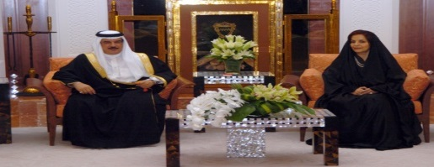
Supreme Council for Women
2001
The Supreme Council for Women was established by Royal Order in 22 August 2001.
Hold conferences, seminars and discussions
Develop a National Plan for the Advancement of Bahraini Women
Propose, and follow up the implementation of public policies
Raise the society’s awareness on women’s role, rights and duties
Conduct Women Empowerment Programs and Initiatives
Establish a documentation center
Key SCW Specializations
6
Notes:
As a result, and based on the recommendation of Her Royal Highness, the Supreme Council for Women was established on August 22nd 2001 by Royal Order as a consultative organization directly reporting to His Majesty the King in all matters that relate to women in the Kingdom of Bahrain, and led by the First lady of Bahrain, Her Royal Highness Princess Sabeeka Bint Ibrahim Al-Khalifa.

Slide 7
Legislative Achievements, Ministerial Decisions and Circulars
2004
2005
2006
- Divorced and Widowed Women benefit from housing services.
- Establishment of an Alimony
Fund.
- Social security added different categories of women to the beneficiary group.
- Giving a sense of urgency on
family law cases.
- Mandatory pre-marital health checks.
- Amendment of marriage contract.
2009
2013
2015
- Issuance of the Family Law.
- Equal social allowance for married women.
- Issuance of the Law on the protection from domestic violence.
- Equality for children of
Bahraini mothers.
Notes:
With great pride, this year, the Supreme Council for Women recognizes 15 years of efforts and achievements since its establishment, and although numerous legislative achievements have taken place such as:
The Family Law
The Protection from Domestic Violence Law
The amendment of the Labour Law of the Private Sector which has taken into consideration the needs of working women

Slide 8
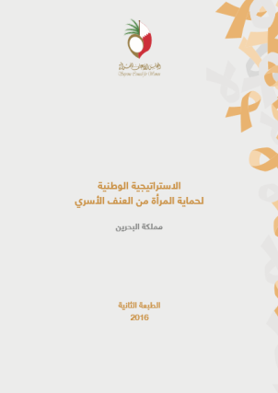
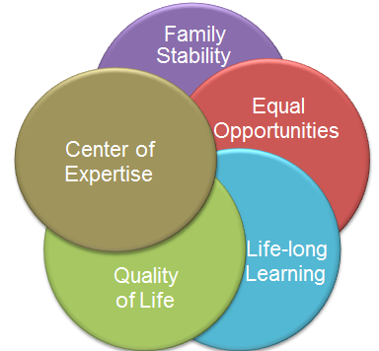
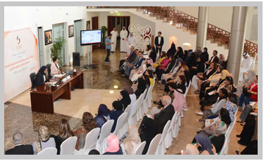

Strategic Implementation Mechanisms
National Plan for the Advancement of Bahraini Women
National Model for Mainstreaming Women’s Needs
National Strategy for the Protection of Women from Domestic Violence.
National Committee for Following up the Implementation of the National Model for Mainstreaming Women’s Needs into development.
Coordination Committee between the (SCW) and the Legislative Authority.
Equal Opportunity Committees
- Mandatory in Public Sector: 42
- Private Sector: 11
Notes:
With great pride, this year, the Supreme Council for Women recognizes 15 years of efforts and achievements since its establishment, and although numerous legislative achievements have taken place such as:
The Family Law
The Protection from Domestic Violence Law
The amendment of the Labour Law of the Private Sector which has taken into consideration the needs of working women

Slide 9
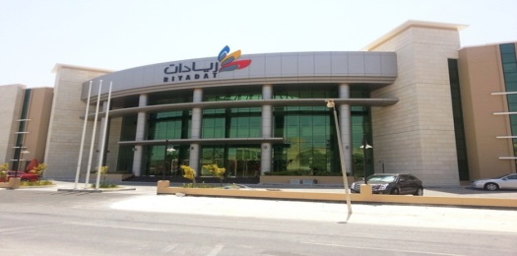
Economic Empowerment Program
Her Royal Highness Princess Sabeeka Bint Ibrahim Al-Khalifa fund in support of commercial activities for women
Bahraini Businesswomen Incubator (Riyadat Center)
Financing loans for micro projects
Financing loans for small and medium projects
Fund
A national initiative between the (SCW) and the Bahrain Development Bank.
Encourage women to start their own project.
Providing advice, capacity-building programs, and funding opportunities for women owned incubators.
Support women entrepreneurs to develop to compete globally.
USD 100 million
USD 5 million

Slide 10
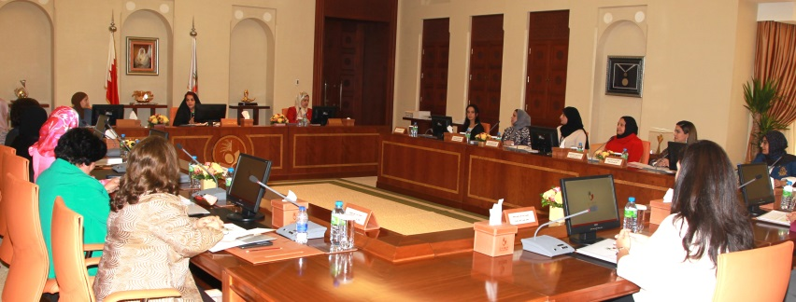
Supreme Council for Women
Vision
Equitable partnership to build a competitive and sustainable society.
Notes:
None-the-less, the role of the Supreme Council for Women is far from complete. We are well aware that there are still areas for further development, in addition to some challenges ahead of us, in which we are dealing with, with attention and responsibility.
However, it is the trust we have in our future generations that drives us today to excel in all areas of women development, where we strongly believe that empowerment is a tool that every woman should realise the importance of, in order to be able to discover the right path and be able to make her own decisions as a productive citizen, and therefore, realize the responsibilities ahead of her to continue in the footsteps of generations of champions who have created a legacy that should live forever.

Slide 11
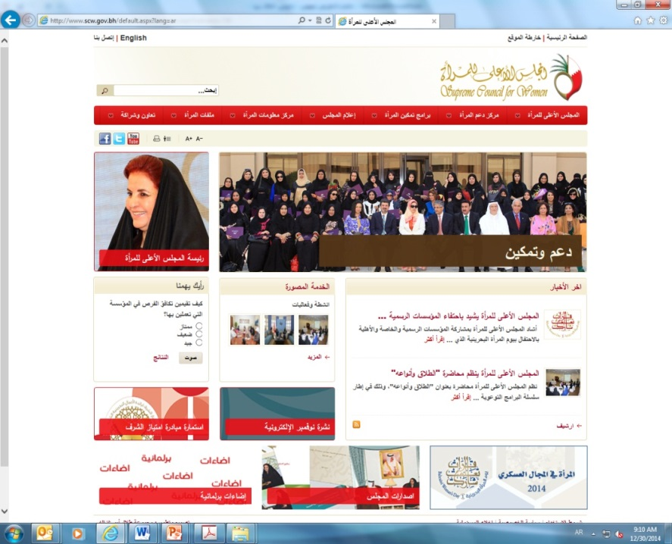
Thank you
www.scw.bh
@scwbahrain

